Slide 1

医药卫生工作报告
The user can demonstrate on a projector or computer, or print the presentation and make it into a film to be used in a wider field
汇报人：ABC

Slide 2

CONTENTS
1 . 标题文字添加此处
The user can demonstrate on a projector or computer
2 . 标题文字添加此处
The user can demonstrate on a projector or computer
3 . 标题文字添加此处
The user can demonstrate on a projector or computer
4 . 标题文字添加此处
The user can demonstrate on a projector or computer

Slide 3


PART 01
标题文字添加此处
The user can demonstrate on a projector or computer, or print the presentation and make it into a film to be used in a wider field

Slide 4

标题文字添加此处
The user can demonstrate on a projector or computer
标题文字添加
The user can demonstrate on a projector or computer, or print the presentation and make it into a film to be used in a wider fieldThe user can demonstrate, or print the presentation and make it into used in a wider fieldThe user can demonstrate on a projector or computer, or print the presentation and make it into a film to be used in a wider field

Slide 5

标题文字添加此处
The user can demonstrate on a projector or computer
标题文字添加
The user can demonstrate on a projector or computer, or print the presentation and make it into a film to be used in a wider field
标题文字添加
The user can demonstrate on a projector or computer, or print the presentation and make it into a film to be used in a wider field
标题文字添加
The user can demonstrate on a projector or computer, or print the presentation and make it into a film to be used in a wider field

Slide 6

标题文字添加此处
The user can demonstrate on a projector or computer
标题文字添加
标题文字添加
The user can demonstrate on a projector or computer, or print the presentation and make it into a film to be used in a wider field
The user can demonstrate on a projector or computer, or print the presentation and make it into a film to be used in a wider field
标题文字添加
标题文字添加
The user can demonstrate on a projector or computer, or print the presentation and make it into a film to be used in a wider field
The user can demonstrate on a projector or computer, or print the presentation and make it into a film to be used in a wider field

Slide 7

标题文字添加此处
The user can demonstrate on a projector or computer
标题文字添加
标题文字添加
标题文字添加
The user can demonstrate on a projector or computer, or print the presentation and make
The user can demonstrate on a projector or computer, or print the presentation and make
The user can demonstrate on a projector or computer, or print the presentation and make

Slide 8

标题文字添加此处
The user can demonstrate on a projector or computer
标题文字添加
标题文字添加
标题文字添加
The user can demonstrate on a projector or computer, or print the presentation and make
The user can demonstrate on a projector or computer, or print the presentation and make
The user can demonstrate on a projector or computer, or print the presentation and make
标题文字添加
标题文字添加
标题文字添加
The user can demonstrate on a projector or computer, or print the presentation and make
The user can demonstrate on a projector or computer, or print the presentation and make
The user can demonstrate on a projector or computer, or print the presentation and make

Slide 9
PART 02
标题文字添加此处
The user can demonstrate on a projector or computer, or print the presentation and make it into a film to be used in a wider field

Slide 10
标题文字添加此处
The user can demonstrate on a projector or computer
2016
2017
2018
2019
文字添加
文字添加
文字添加
文字添加
The user can demonstrate on a projector or computer, or print the presentation and make it into a film
The user can demonstrate on a projector or computer, or print the presentation and make it into a film
The user can demonstrate on a projector or computer, or print the presentation and make it into a film
The user can demonstrate on a projector or computer, or print the presentation and make it into a film

Slide 11
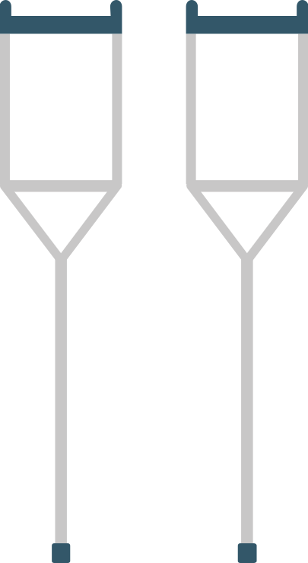
标题文字添加此处
The user can demonstrate on a projector or computer
标题文字添加
标题文字添加
The user can demonstrate on a projector or computer, or print the presentation and make it into a film to be used in a wider field
The user can demonstrate on a projector or computer, or print the presentation and make it into a film to be used in a wider field
标题文字添加
标题文字添加
The user can demonstrate on a projector or computer, or print the presentation and make it into a film to be used in a wider field
The user can demonstrate on a projector or computer, or print the presentation and make it into a film to be used in a wider field
标题文字添加
标题文字添加
The user can demonstrate on a projector or computer, or print the presentation and make it into a film to be used in a wider field
The user can demonstrate on a projector or computer, or print the presentation and make it into a film to be used in a wider field

Slide 12
标题文字添加此处
The user can demonstrate on a projector or computer
标题文字添加
标题文字添加
标题文字添加
标题文字添加
The user can demonstrate on a projector or computer, or print the presentation and make
The user can demonstrate on a projector or computer, or print the presentation and make
The user can demonstrate on a projector or computer, or print the presentation and make
The user can demonstrate on a projector or computer, or print the presentation and make

Slide 13



标题文字添加此处
The user can demonstrate on a projector or computer
标题文字添加
The user can demonstrate on a projector or computer, or print the presentation and make it into a film to be used in a wider field
标题文字添加
The user can demonstrate on a projector or computer, or print the presentation and make it into a film to be used in a wider field

Slide 14


标题文字添加此处
The user can demonstrate on a projector or computer
标题文字添加
The user can demonstrate on a projector or computer, or print the presentation and make it into a film to be used in a wider field
标题文字添加
The user can demonstrate on a projector or computer, or print the presentation and make it into a film to be used in a wider field
标题文字添加
The user can demonstrate on a projector or computer, or print the presentation and make it into a film to be used in a wider field

Slide 15
PART 03
标题文字添加此处
The user can demonstrate on a projector or computer, or print the presentation and make it into a film to be used in a wider field

Slide 16

标题文字添加此处
The user can demonstrate on a projector or computer
标题文字添加
标题文字添加
The user can demonstrate on a projector or computer, or print the presentation and make it into a film to be used in a wider field
The user can demonstrate on a projector or computer, or print the presentation and make it into a film to be used in a wider field
标题文字添加
标题文字添加
The user can demonstrate on a projector or computer, or print the presentation and make it into a film to be used in a wider field
The user can demonstrate on a projector or computer, or print the presentation and make it into a film to be used in a wider field

Slide 17

标题文字添加此处
The user can demonstrate on a projector or computer
标题文字添加
The user can demonstrate on a projector or computer, or print the presentation and make it into a film to be used in a wider field
标题文字添加
The user can demonstrate on a projector or computer, or print the presentation and make it into a film to be used in a wider field
标题文字添加
The user can demonstrate on a projector or computer, or print the presentation and make it into a film to be used in a wider field

Slide 18


标题文字添加此处
The user can demonstrate on a projector or computer
标题文字添加
The user can demonstrate on a projector or computer, or print the presentation and make
标题文字添加
The user can demonstrate on a projector or computer, or print the presentation and make

Slide 19
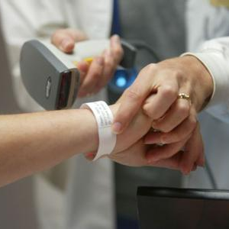

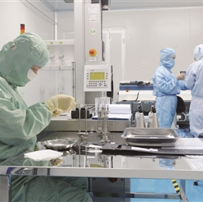

标题文字添加此处
The user can demonstrate on a projector or computer
标题文字添加
The user can demonstrate on a projector or computer, or print the presentation and make it into a film to be used in a wider fieldThe user can demonstrate, or print the presentation and make it into wider fieldThe user can demonstrate on a projector or computer, or print the presentation and make it into a film to be used in a wider field

Slide 20
PART 04
标题文字添加此处
The user can demonstrate on a projector or computer, or print the presentation and make it into a film to be used in a wider field

Slide 21

标题文字添加此处
The user can demonstrate on a projector or computer
标题文字添加
标题文字添加
The user can demonstrate on a projector or computer, or print the presentation and make it into a film to be used in a wider field
The user can demonstrate on a projector or computer, or print the presentation and make it into a film to be used in a wider field
标题文字添加
标题文字添加
The user can demonstrate on a projector or computer, or print the presentation and make it into a film to be used in a wider field
The user can demonstrate on a projector or computer, or print the presentation and make it into a film to be used in a wider field

Slide 22


标题文字添加此处
The user can demonstrate on a projector or computer
标题文字添加
标题文字添加
The user can demonstrate on a projector or computer, or print the presentation and make it into a film to be used
The user can demonstrate on a projector or computer, or print the presentation and make it into a film to be used
标题文字添加
标题文字添加
The user can demonstrate on a projector or computer, or print the presentation and make it into a film to be used
The user can demonstrate on a projector or computer, or print the presentation and make it into a film to be used
标题文字添加
标题文字添加
The user can demonstrate on a projector or computer, or print the presentation and make it into a film to be used
The user can demonstrate on a projector or computer, or print the presentation and make it into a film to be used

Slide 23
标题文字添加此处
The user can demonstrate on a projector or computer
标题文字添加
The user can demonstrate on a projector or computer, or print the presend make it into a film to be used in a wider fieldThe user can demonstrate on a projector or computer, or print the presentation and make it into a film to be used in a wider field

Slide 24

标题文字添加此处
The user can demonstrate on a projector or computer
标题文字添加
标题文字添加
The user can demonstrate on a projector or computer, or print the presentation and make it into a film to be used in a wider field
The user can demonstrate on a projector or computer, or print the presentation and make it into a film to be used in a wider field

Slide 25
感谢您的观看
The user can demonstrate on a projector or computer, or print the presentation and make it into a film to be used in a wider field
汇报人：ABC

Slide 26
更多精品PPT资源尽在—优品PPT！
www.ypppt.com
PPT模板下载：www.ypppt.com/moban/ 节日PPT模板：www.ypppt.com/jieri/
PPT背景图片：www.ypppt.com/beijing/ PPT图表下载：www.ypppt.com/tubiao/
PPT素材下载： www.ypppt.com/sucai/ PPT教程下载：www.ypppt.com/jiaocheng/
字体下载：http://www.ypppt.com/ziti/ 绘本故事PPT：http://www.ypppt.com/gushi/
Notes:
模板来自于 http://www.ypppt.com

