Slide 1

红色商务报告模板
BUSINESS REPORT SUMMARIZES TEMPLATE
汇报人：优品PPT

Slide 2
目录
CONTENTS
PART 1
PART 2
PART 3
PART 4
Go to the sea,
if you would fish well.
There's as good fish in
sea as ever came
Go to the sea,
if you would fish well.
There's as good fish in sea as ever came

Slide 3
PART 1
It is a silly fish that is caught twice with the same bait.

Slide 4

公司介绍
基本情况
BASIC SITUATION
Be always as merry as ever you can, for no-one delights in a sorrowful man. Be always as merry as ever you can, for no-one delights in a sorrowful man.
1234K
234，781RMB
4.78BM
Beauty is potent; but money is omnipotent.
04

Slide 5




公司介绍
灵魂人物
THE CORE CHARACTER
Be always as merry as ever you can, for no-one delights in a sorrowful man. Be always as merry as ever you can, for no-one delights in a sorrowful man.
05

Slide 6
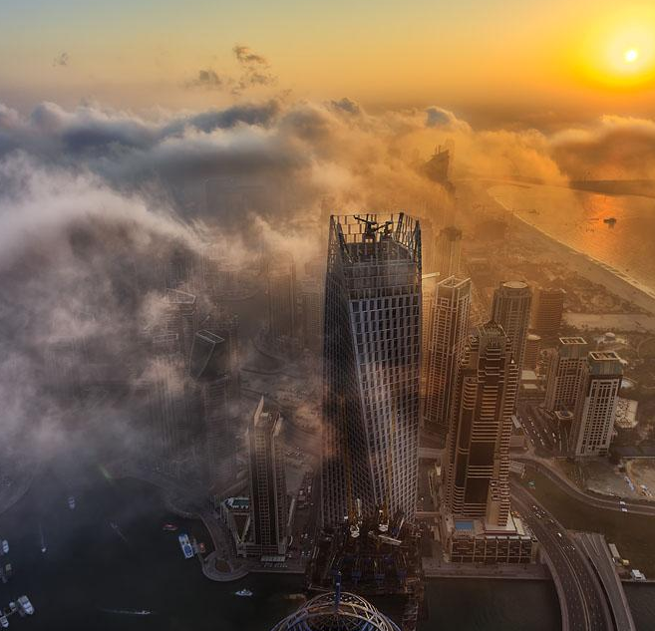
公司介绍
基本情况
BASIC SITUATION
Be always as merry as ever you can, for no-one delights in a sorrowful man. Be always as merry as ever you can, for no-one delights in a sorrowful man.
50% OFF
06

Slide 7
公司介绍
DRIBBLE
PINTEREST
BEHANCE
FACEBOOK
Better a little fire to warm us, than a great one to burn us
Bed is a medicine.
09

Slide 8
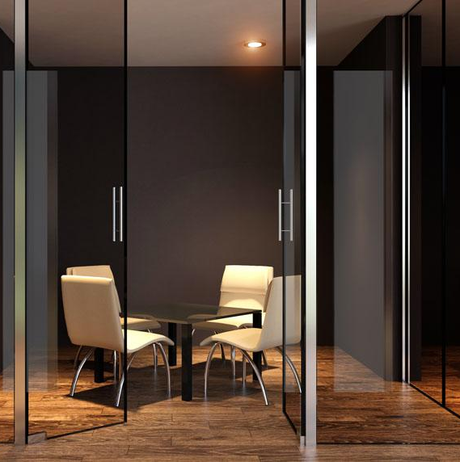
公司介绍
产品介绍
BASIC SITUATION
Be always as merry as ever you can, for no-one delights in .
ready

Slide 9


BASIC SITUATION
BASIC SITUATION
Be always as merry as ever you can, for no-one delights in an sorrowful man.
BASIC SITUATION
基本情况
BASIC SITUATION
Be always as merry as ever you can, for no-one delights in an sorrowful man.
12

Slide 10




公司介绍
基本情况
BASIC SITUATION
Be always as merry as ever you can, for no-one delights in an sorrowful man.
基本情况
Be always as merry as ever you can, for no-one delights .
BASIC SITUATION
Be always as merry as ever you can, for no-one delights in an sorrowful man.
Be always as merry as ever she can, for no-one delights in an sorrowful man.

Slide 11
公司介绍
RMB 5,000,000
2017年预测利润
100P
店铺数量预计亚太+中国可达到100家
19

Slide 12
可用图标

Slide 13
更多精品PPT资源尽在—优品PPT！
www.ypppt.com
PPT模板下载：www.ypppt.com/moban/ 节日PPT模板：www.ypppt.com/jieri/
PPT背景图片：www.ypppt.com/beijing/ PPT图表下载：www.ypppt.com/tubiao/
PPT素材下载： www.ypppt.com/sucai/ PPT教程下载：www.ypppt.com/jiaocheng/
Notes:
模板来自于 http://www.ypppt.com

