Slide 1
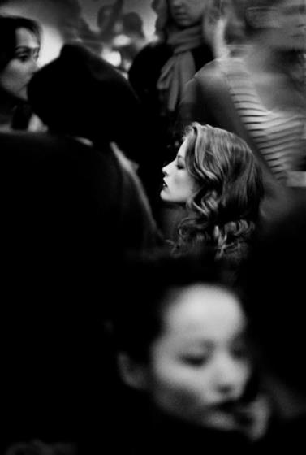
Lonely as a Cloud
A LONELY PPT

Slide 2
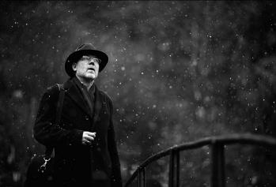
Lonely as a Cloud
A lonely power point
Lonely
As a cloud
I Wandered Lonely as a Cloud
William Wordsworth
I wandered lonely as a cloud
That floats on high o'er vales and hills
When all at once I saw a crowd,
A host, of golden daffodils;

Slide 3
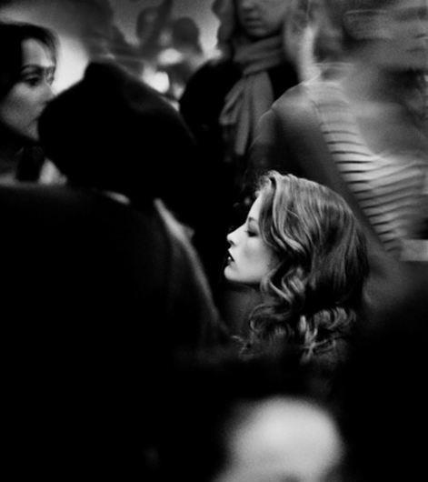
Lonely as a Cloud
A lonely power point
Lonely as a Cloud
For oft, when on my couch I lie
In vacant or in pensive mood,
They flash upon that inward eye
Lonely as a Cloud
The waves beside them danced; but they
Out-did the sparkling waves in glee:
A poet could not but be gay
Lonely as a Cloud
The waves beside them danced; but they
Out-did the sparkling waves in glee:
A poet could not but be gay
The waves beside them danced; but they
Out-did the sparkling waves in glee:
A poet could not but be gay
Lonely as a Cloud
The waves beside them danced; but they
Out-did the sparkling waves in glee:
A poet could not but be gay

Slide 4
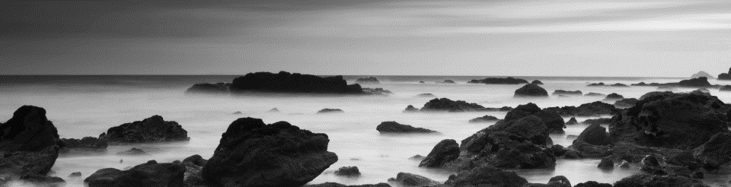
Lonely as a Cloud
A lonely power point
Lonely as a Cloud
Lonely as a Cloud
The waves beside them danced; but they
Out-did the sparkling waves in glee:
A poet could not but be gay

Slide 5

Lonely as a Cloud
A lonely power point
Lonely
as a Cloud
I Wandered Lonely as a Cloud
William Wordsworth
I wandered lonely as a cloud
That floats on high o'er vales and hills
When all at once I saw a crowd,
A host, of golden daffodils;
01
Lonely as a Cloud
02
Lonely as a Cloud
03
Lonely as a Cloud

Slide 6


Lonely as a Cloud
A lonely power point
Lonely as a Cloud
I Wandered Lonely as a Cloud
William Wordsworth
I wandered lonely as a cloud
That floats on high o'er vales and hills
When all at once I saw a crowd,
A host, of golden daffodils;

Slide 7

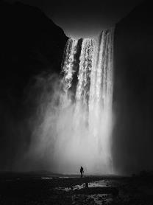
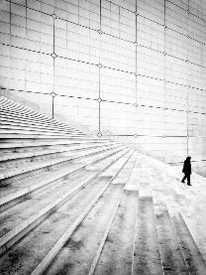

Lonely as a Cloud
A lonely power point
Lonely
As a Cloud
I Wandered Lonely as a Cloud
William Wordsworth
I wandered lonely as a cloud
I Wandered Lonely as a Cloud .William Wordsworth .I wandered lonely as a cloud.hat floats on high o'er vales and hills .When all at once I saw a crowd, A host, of golden daffodils;

Slide 8
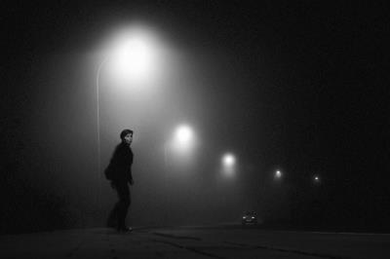
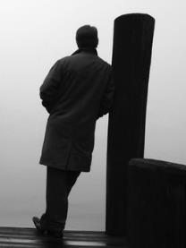
Lonely as a Cloud
A lonely power point
Lonely
As a Cloud
I Wandered Lonely as a Cloud
William Wordsworth
I wandered lonely as a cloud

Slide 9
更多精品PPT资源尽在—优品PPT！
www.ypppt.com
PPT模板下载：www.ypppt.com/moban/ 节日PPT模板：www.ypppt.com/jieri/
PPT背景图片：www.ypppt.com/beijing/ PPT图表下载：www.ypppt.com/tubiao/
PPT素材下载： www.ypppt.com/sucai/ PPT教程下载：www.ypppt.com/jiaocheng/
Notes:
模板来自于 http://www.ypppt.com

